Slide 1
Natural Language Processing Project (Machine Learning) News articles classification
Yuval Kogos – Oct 2019

Slide 2

Work Flow
1. Find the best algorithm for text processing which the output can be fitted to a ML model.
2. Try the algorithm on a simple Neural Network algorithm to get basic results.
3. Optimize the text processing algorithm based on the results from the NN algorithm and create the final dataset.
4. Run a simple Decision Tree algorithm on the dataset.
5. Optimize the Decision Tree algorithm to reach maximum results.
6. Repeat steps 4-5 on several models such as (RNN,LSTM,SVM,SGD…) and take the best results.
7. Optional: Develop a script that will use the model
Preparing the Dataset
Objective: reach accuracy score > 80%

Slide 3
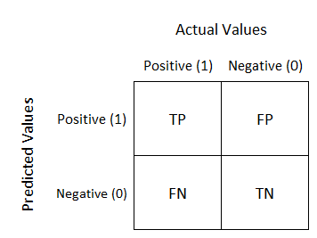


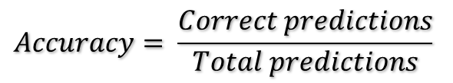
Results Evaluation Metrics
How to evaluate the results
In any machine learning project, we need to find a good performance assessment tool that matches the problem, and give us a good indication of how close we are to achieving the target.
The 4 main strong metrics I will use are: Accuracy Score, Confusion Matrix, Precision and Recall.
Accuracy Score is simply how accurate my predictions comparing to the actual data. The formula for computing the accuracy score is:
Confusion matrix is a table that show for each prediction, it’s corresponding true value. Meaning, I can see how correct my predictions are for each class. For example, say I have a tool for predicting if an animal is a cat or a dog, I can use the following confusion matrix to see how many dogs are predicted as dogs, how many are predicted as cats, how many cats are predicted as cats, and how many as dogs.
$$Accuracy= \frac{Correct predictions}{Total predictions}$$
50
3
7
47

Slide 4

Preparing the Dataset
Part 1

Slide 5
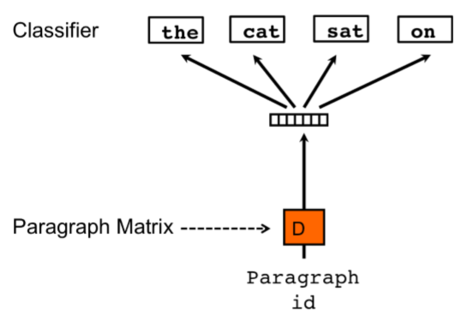
Preparing the dataset
DOC2VEC model
After some research I found that the best model to fit my dataset is the “Doc2Vec” (Document to Vector) model.
The Doc2Vec model takes a text document (paragraph) and turns it into a vector of numbers that the Machine Learning model can process as input.
For further information: https://medium.com/wisio/a-gentle-introduction-to-doc2vec-db3e8c0cce5e

Slide 6
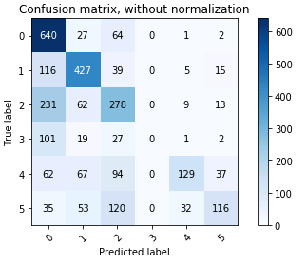

Preparing the dataset
DOC2VEC model
After some basic implementation of the Doc2Dec model on python, I tried to run it on a simple un-optimized LBGM algorithm. The confusion matrix and accuracy are as follows:
We can see that the results wasn’t good at all (accuracy of 56% is very close to random…) meaning: I have a lot of work … ☹

Slide 7
Preparing the dataset
DOC2VEC model optimization
After some research on how I can get the best results from the Doc2Vec model, I found some more features I can add to the script:
Eliminate low frequencies
Lemmatization
NLTK

Slide 8

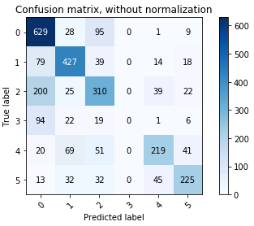
Preparing the dataset
DOC2VEC model optimization
After running the dataset created by the optimized Doc2Vec model on the same LBGM model, we can see some improvements (10%):
Un-optimized dataset results
optimized dataset results
VS

Slide 9
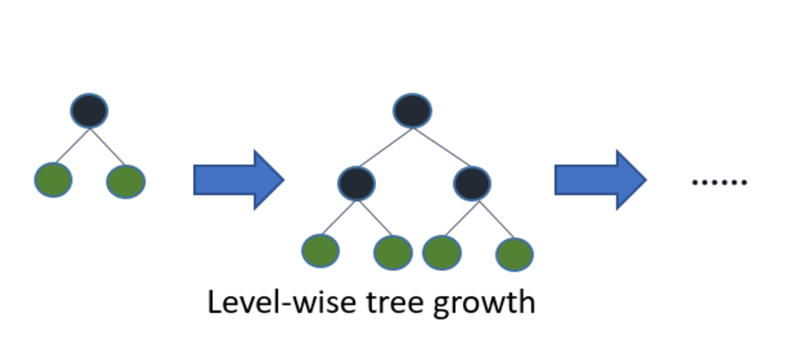
LGBM algorithm (Decision Tree)
Part 2

Slide 10
LGBM Algorithm
LGBM model optimization
After getting the Doc2Vec model ready, and processing the final database (which will be fit to my ML models), I’ve tried to think on ways to optimize my LGBM model to get the best performance possible. This process called hyperparameters optimization, and these are 2 of the most common methods:
Genetic Algorithm: very common optimization method inspired by the process of natural selection, that belongs to the larger class of evolutionary algorithms.
Grid Search: The traditional way of performing parameters optimization. Grid Search is simply an exhaustive searching through a manually prepared range of values for each parameter.

Slide 11

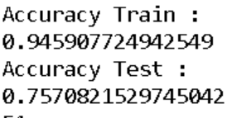
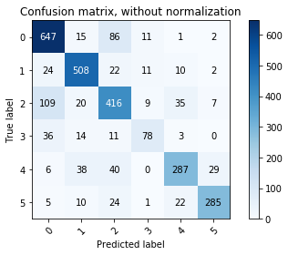
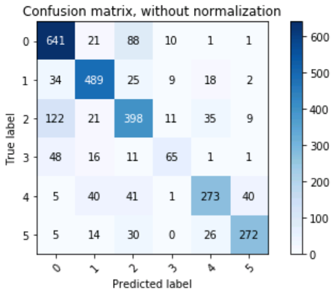
LBGM Algorithm
LBGM model optimization - results
Un-Optimized model | Grid Search | GA results
We can see that the Grid Search method did the best optimization, so it’s result params will be the parameters I will use at the final LGBM model.

Slide 12
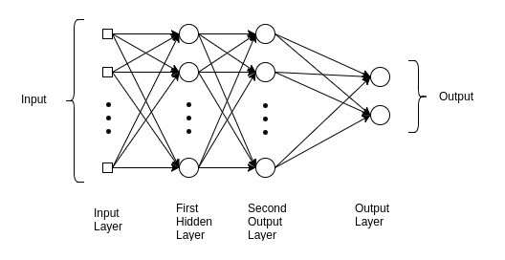
MLP (Neural Network) algorithm
Part 3

Slide 13
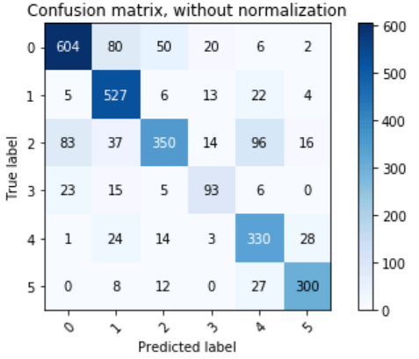

MLP Algorithm
MLP model
After achieving the best result possible from the LBGM algorithm, its time to test some other Machine Learning models. The next one I tested is MLP (Multi Layer Perceptron).
The results from the base model with the default parameters (without optimization) are as follows:

Slide 14
MLP Algorithm
MLP model optimization
After getting the basic results with the default parameters, it’s time to do some optimization to the MLP model hyper-parameters. I’ll use the same methods as at the LBGM algorithm:
Grid Search (GS)
Genetic Algorithm (GA)
The results are at the next slide ->

Slide 15


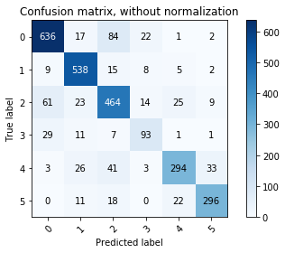
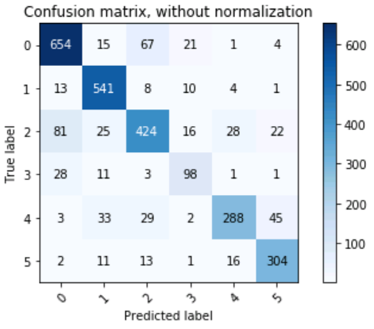
MLP Algorithm
MLP model optimization - results
Un-Optimized model | Grid Search | GA results
We can see that the Grid Search method did the best optimization in this model too, so it’s result params will be the parameters I will use at the final MLP model also.

Slide 16

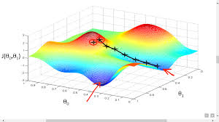
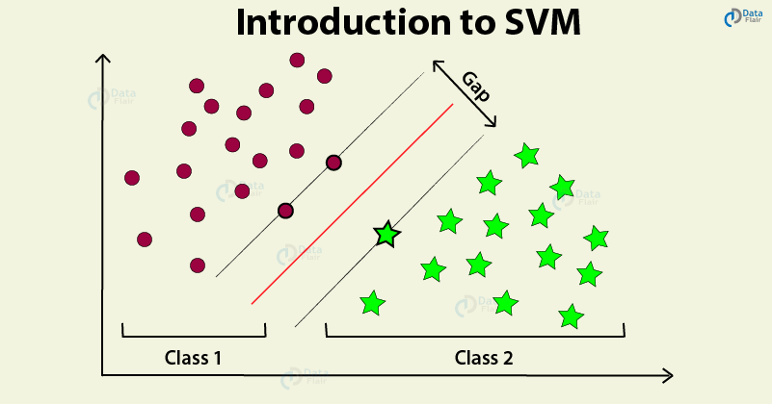
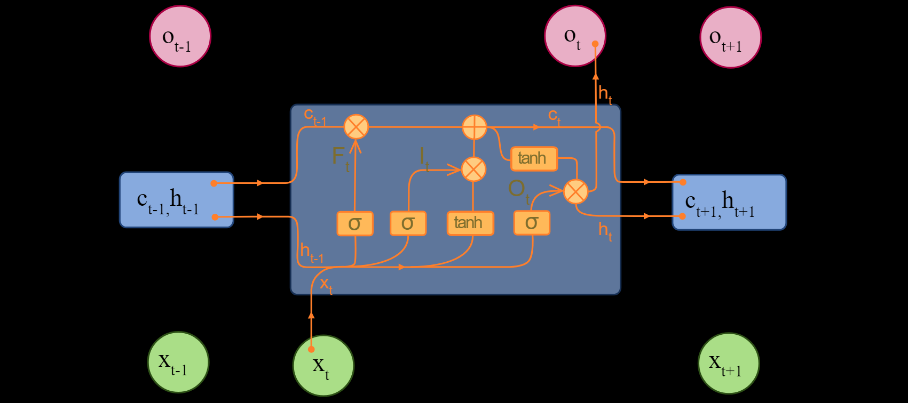
Testing other models…
Part 4

